Slide 1
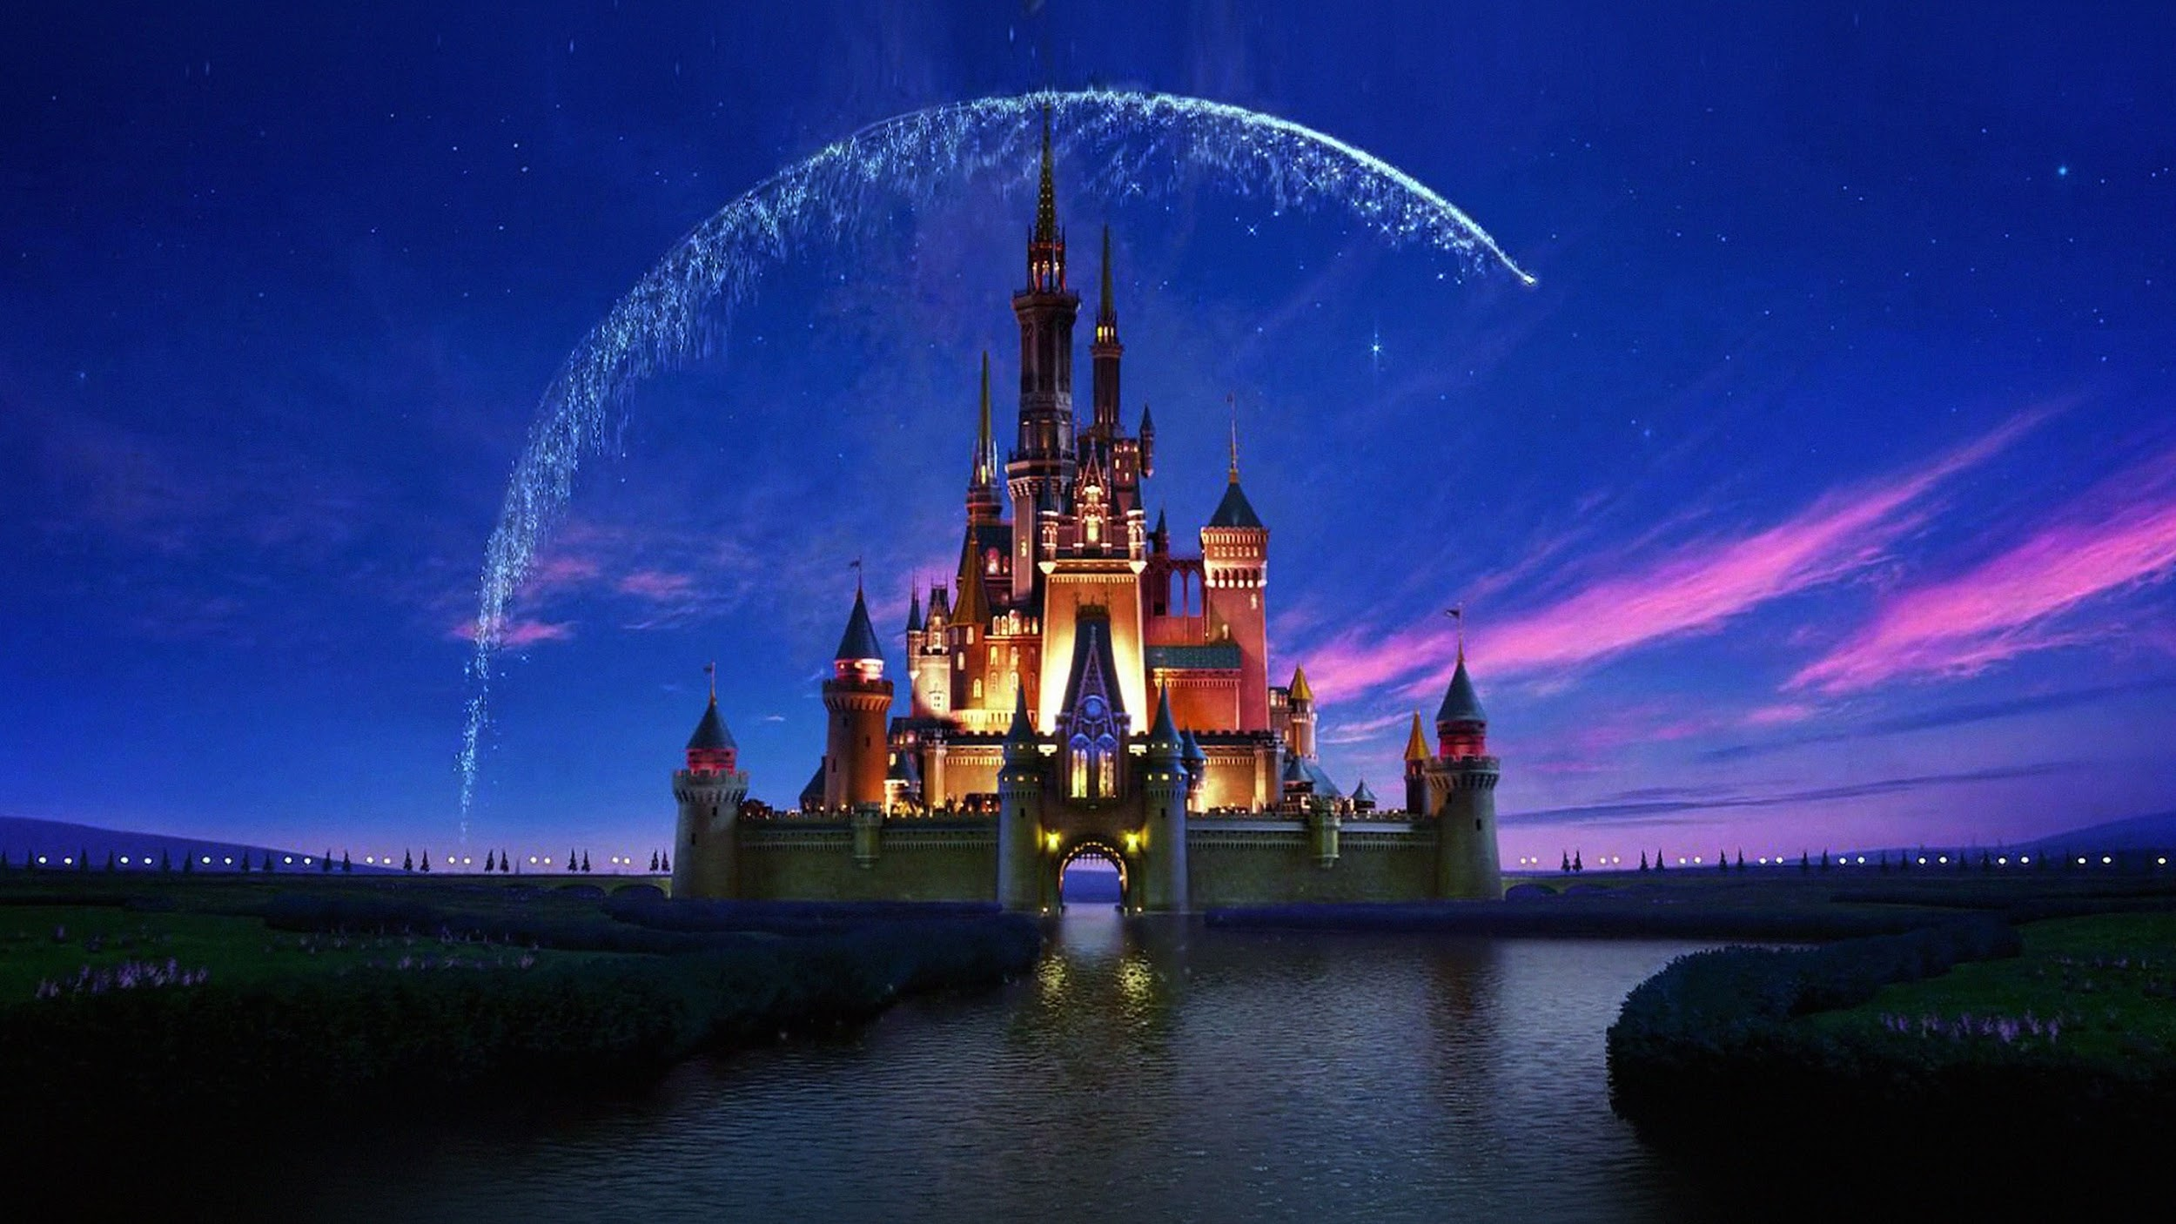
Stream Vision Consulting Group
Disney vs Netflix: Reimagining Disney’s Future in the Streaming Era
Aiden Mclean, Gyuhyoun K. (Evelyn), Jason V., Taslima S., Tamerlan K., Ngai Wong (Kelvin)

Slide 2
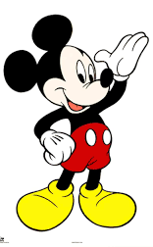
The Magic Kingdom
What Disney stood for: family-friendly entertainment, magic, storytelling, and strong brand nostalgia.
How consumers saw Disney: A brand trusted for quality and childhood memories, and a timeless leader in movies, theme parks, and merchandise.
Pre-disruption media landscape: Disney dominated in theaters, cable TV (Disney Channel, ABC), and merchandising.
Founded in 1923
Walt Disney

Slide 3




THE HISTORY OF DISNEY
2011 - 2023
2006 - 2011
1985 - 2006
1983 - 1985

Slide 4
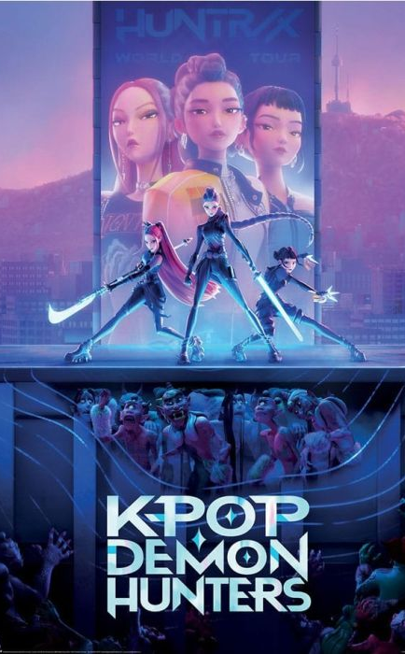
Background of Netflix
Founded in 1997 as a DVD-by-mail rental service.
Shifted to streaming in 2007, becoming one of the first major platforms to offer on-demand digital video.
Expanded globally starting in 2010, now available in over 190 countries.
Began producing original content in 2013 (starting with House of Cards), transforming it into a major entertainment studio.
Known for its subscription-based, ad-free model, personalized recommendations, and data-driven content strategy.
Became the leading streaming competitor, influencing traditional media companies to launch their own services (like Disney+ and Hulu).

Slide 5

Disruption and Impact
Disruption
The rise of streaming services
On-demand, no ads, binge model
01
02
Quantify the Impact
Declining cable subscriptions
Lower theatrical revenues
Shifting consumer attention to digital platforms.
Qualify the impact
Consumer expectations moved from scheduled programming to convenience, affordability, and content variety.
03
Disney+ and Hulu
Launched in 2019 and became central to Disney’s digital transformation along with Hulu
Disney+ for family-friendly content
Hulu for more mature programming, which strengthened its streaming system.
04

Slide 6
Overall Subscriber Count
301.6 Millions
131.6 Millions
64.1 Millions
Netflix
Disney+
Hulu

Slide 7
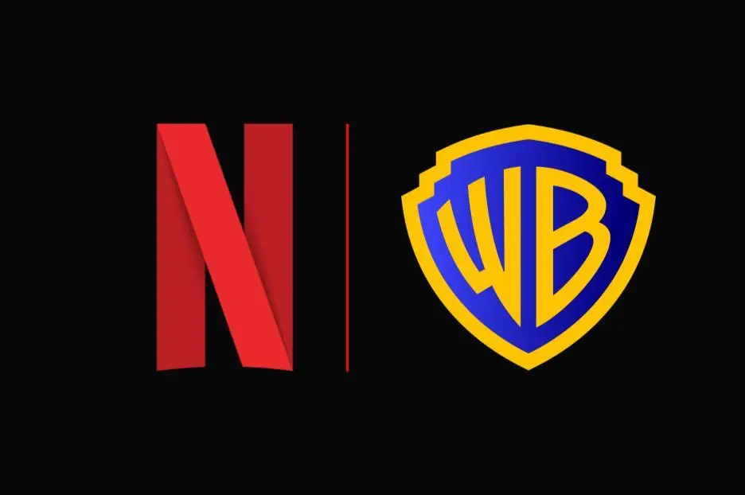
Netflix to Acquire Warner Bros. Following the Separation of Discovery Global for a Total Enterprise Value of $82.7 Billion (Equity Value of $72.0 Billion)

Slide 8
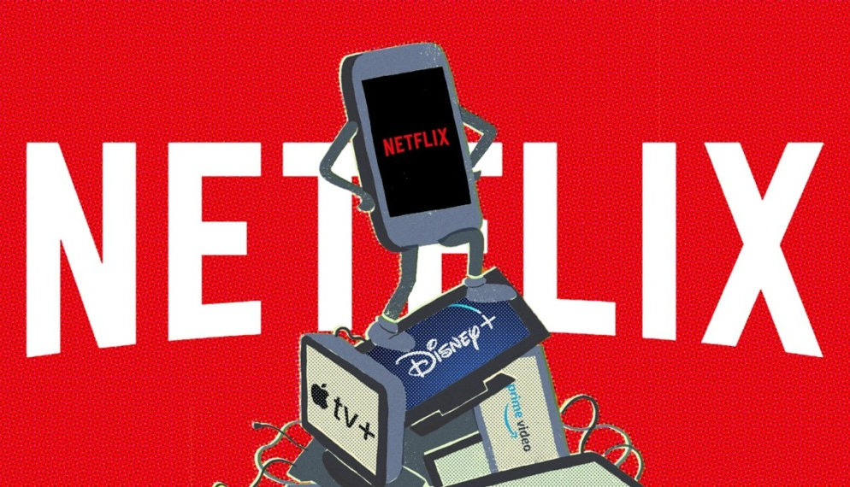
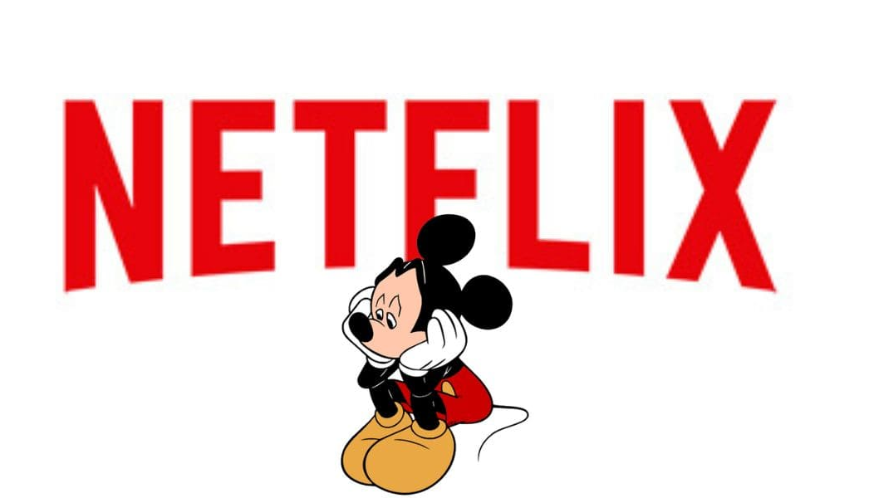
Competitor Analysis
Netflix
Market leader with massive global reach
Large library of original content
Lacks family-focused identity
Amazon Prime Video
Bundled with Amazon Prime for added value
Strong budget for originals
Less focused on pure entertainment
Max (HBO)
Known for premium, adult-oriented content
Smaller library compared to Disney+
Targets older audiences

Slide 9
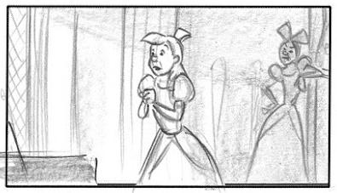
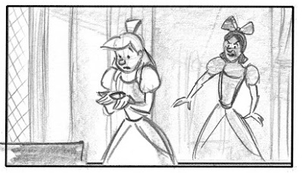
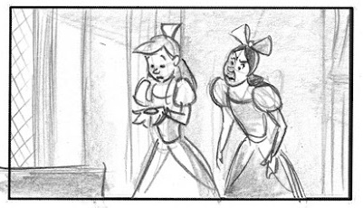
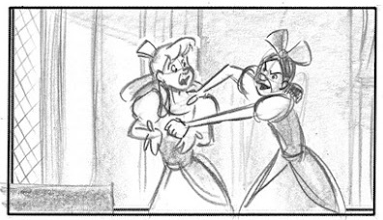
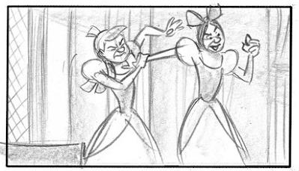
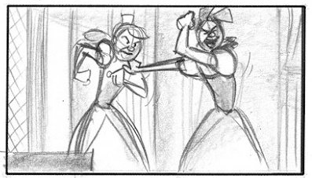
Competitor Analysis Cont.
Apple TV
High-quality, award-winning originals
Premium brand reputation
Limited content for families
Disney+ Competitive Advantages
Exclusive, iconic franchises (Marvel, Pixar, Star Wars)
Trusted, family-friendly brand
Integrated ecosystem across streaming, parks, and merchandise

Slide 10

5Cs
Company
strong IP, legacy, theme parks, global reach
Customers
families, young adults, global viewers
Competitors
Netflix, Amazon, hulu, etc.
Collaborators
Pixar, Marvel, ESPN, etc
Context
changing digital behavior, tech-driven market

Slide 11

Market Assessment for Disney
PESTLE:
Political: regulations on content and data privacy
Economic: inflation, changing consumer spending on subscriptions
Social: shift toward personalized, mobile entertainment
Technological: AI-based recommendations, streaming innovations
Legal: copyright, licensing, global IP issues
Environmental: sustainable production practices (bonus if relevant)

Slide 12

Market Assessment for Disney
5 Forces:
Competitive rivalry or competition: Strong force
Bargaining power of buyers or customers: Strong force
Bargaining power of suppliers: Weak force
Threat of substitutes or substitution: Moderate force
Threat of new entrants or new entry: Weak force

Slide 13
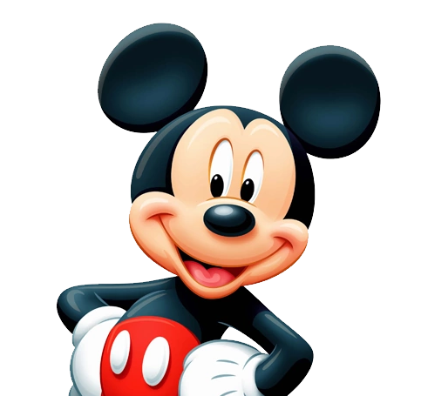

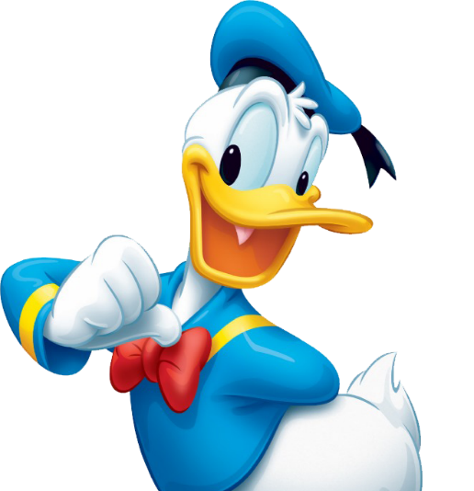

SWOT ANALYSIS
Strength
Weakness
Opportunities
Threats
Strong IP Library ( Marvel, Star Wars, Pixar, Disney)
Global Brand recognition and trust
Financial resources to invest in higher scale content
Able to integrate content in their parks, merchandise
Weaker recommendation algorithm than Netflix
Less content variety and lower release volume
Over Reliance on established franchises risking fatigue
Limited appeal to non family content unlike netflix
Growing global demand for safe, kid-friendly streaming content.
Expansion of localized content for non-US markets.
Cross-platform synergy (parks + streaming + retail + cruises).
AI-driven personalization to reduce search fatigue.
Growing appetite for nostalgia-driven content (live-action remakes, legacy franchises).
Netflix’s global dominance and first-mover advantage.
Subscription fatigue and rising consumer price sensitivity.
Competition from Amazon, Max, Apple TV+, YouTube.
Piracy and password-sharing undermining subscription growth.
Market saturation and shifting attention to gaming/social platforms.
Notes:
4

Slide 14
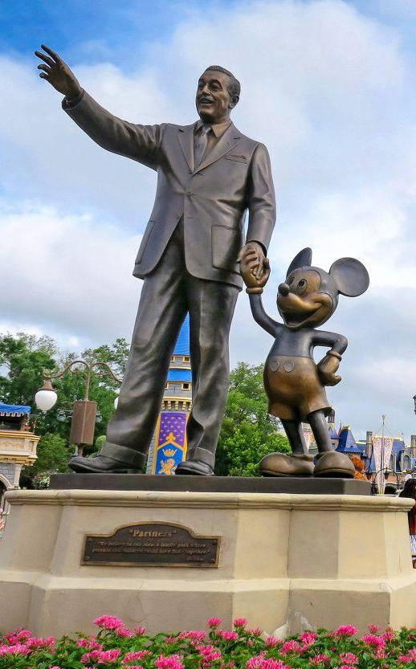
Insight
Discovery - Disney still trusted for magic and imagination
Issue - Too many sequels and remakes creates less excitement and lowers emotional impact
Consumer Belief - They will re-engage and spend for new iconic characters and original stories
Expectation - Authentic, emotional storytelling, not formulaic or forced
Brand Advantage - Disney owns magic and can create the next cultural icons
Strategic Implication - Shift from nostalgia to future-building innovation
Notes:
5:37

Slide 15
Strategic Direction
Create New Magic to Lead Again
Invest in original IP to reignite excitement
Build new iconic characters and storytelling worlds
Strengthen immersive experiences (streaming, parks & gaming)
Prioritize authentic emotional storytelling
Restore Disney’s leadership in imagination and wonder
Goal
Win back audience passion and sustain growth through innovation
Notes:
7

Slide 16

Targeting
Primary Target - Gen Z and Gen Alpha families
Digital-native fans
Highly engaged in streaming and gaming
Shaping future franchise loyalty
Secondary Target - Millennial Parents
Strong nostalgia for Disney
High willingness to spend on family entertainment
Want new magical experiences to share with their kids
Notes:
8:40

Slide 17
Brand Positioning
Rational Benefit
Access to premium, high-quality content across iconic franchises.
Safe, curated environment for families and children.
Intuitive user experience with age-based profiles and parental controls.
Exclusive titles unavailable on any other platform.
Emotional Benefit
Nostalgia, childhood magic, and multi-generational family bonding.
Trust parents feel confident letting children watch without monitoring.
Sense of wonder, immersion, and emotional attachment to beloved characters.
Belonging to a global fan community (Marvel fans, Star Wars fans, Disney fans)
Notes:
10:25

Slide 18
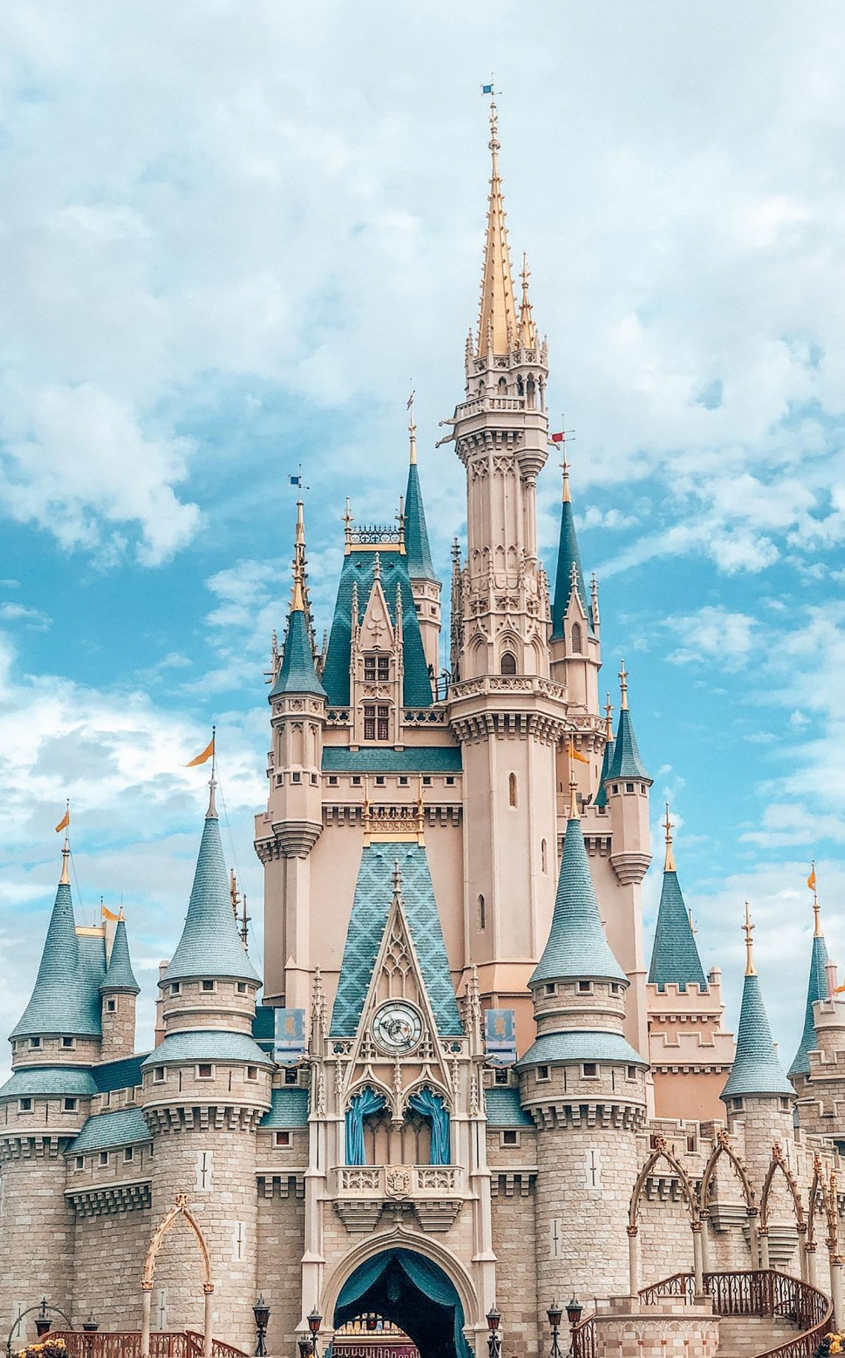
Brand Positioning
Reason to Believe
100+ years of storytelling excellence.
Ownership of world-renowned franchises and universally loved characters.
Disney’s consistent global brand reputation for quality and safety.
Cross-platform ecosystem that deepens experiences (parks, cruises, merchandise).
Notes:
11:10

Slide 19
Brand Positioning
Proposed Change
Shift focus from content volume to curation and trust.
Emphasize Disney’s unmatched emotional storytelling over algorithm driven content dumps.
Highlight family first identity something Netflix cannot authentically own.
Position Disney+ as the safest, most magical, most trusted streaming home for families.
Notes:
12:

Slide 20
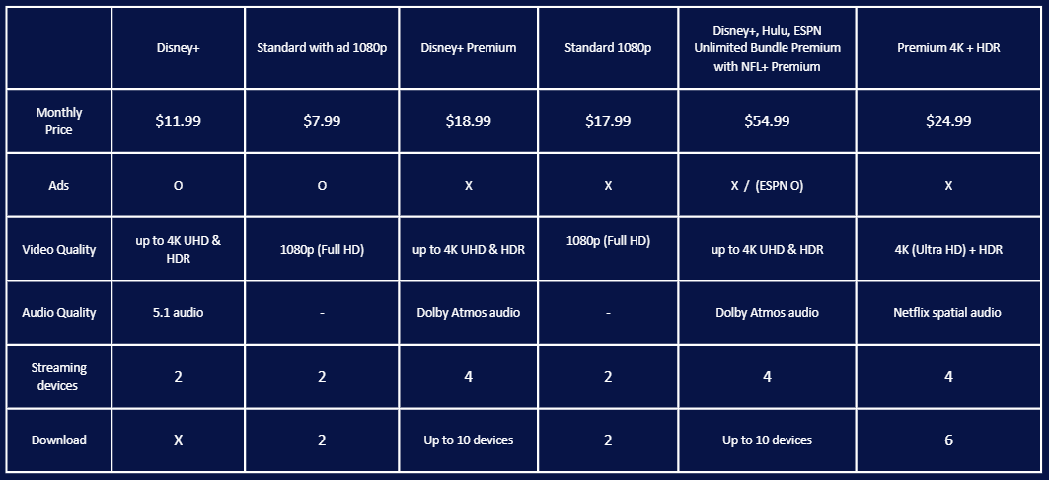

Membership - Monthly Plan

Slide 21
Marketing Plan (4Ps)
PRODUCT
PRICE
Experience
Content: Films (Marvel, Pixar, Lucasfilm), Streaming (Disney+), TV Networks
Experiences: Theme Parks, Resorts, Cruise Lines
Goods: Licensed Merchandise, Games, Publishing
Value of the brand's 'magic' and experience
Dynamic Pricing: Ticket prices fluctuate based on demand, date, and season (peak vs. off-peak)
Tiered Pricing: Offering a range of options (Value, Moderate, Deluxe) to capture all market segments
Service Pricing: Competitive and often bundled (Disney+, Hulu, ESPN+) to maximize subscription value

Slide 22
Marketing Plan (4Ps)
PLACE
PROMOTION
Anytime, anywhere (Physical and Digital)
Physical Channels (Experiential Anchors):
Global Theme Parks & Resorts.
Disney Cruise Line
Retail stores and Licensed Partner Stores (e.g., Target)
Digital Channels (Direct-to-Consumer):
Disney+ (Streaming)
ShopDisney.com (E-commerce)
Theme Parks: New meet-and-greets, parades, or dedicated land expansions
Streaming: Exclusive behind-the-scenes content and sequel series on Disney+
Merchandise: Driving sales of toys, apparel, and games through retail partners
Media Channels: Trailers and segments running on ABC, ESPN, and Disney Channel
Data-Driven Targeting: Utilizing the massive Disney Audience Graph for hyper-personalized advertising and content recommendations on Disney+, ensuring the right ad reaches the right viewer at the right time

Slide 23
Thank You!

Slide 24
https://thewaltdisneycompany.com/about/
https://help.disneyplus.com/article/disneyplus-price?redirect=false
https://www.foxbusiness.com/markets/disney-losing-30m-week-youtube-tv-blackout-drags-on-analysts-say
https://finance.yahoo.com/news/price-standoff-disney-losses-wins-132839068.html?fr=sycsrp_catchall
https://www.crispidea.com/netflix-vs-disney-streaming-war-2025/
https://businessmodelanalyst.com/disney-pestle-analysis/
https://panmore.com/walt-disney-company-five-forces-analysis-porters-recommendations
https://businesschronicler.com/competitors/disney-competitors-analysis/
https://d23.com/about-walt-disney/

Slide 25
Disruption and Impact
Disruption
The rise of streaming services
changed how people consume entertainment (on-demand, no ads, binge model).
01
02
Quantify the Impact
Declining cable subscriptions, lower theatrical revenues, shifting consumer attention to digital platforms.
Qualify the impact
Consumer expectations moved from scheduled programming to convenience, affordability, and content variety.
03
Disney+ and Hulu
Disney+ launched in 2019 and became central to Disney’s digital transformation. Along with Hulu (which Disney now controls), the two platforms allow Disney to target different audiences. Disney+ for family-friendly content and Hulu for more mature programming, which strengthened its streaming system.
04

